Slide 1
Realization of the Erasmus+ project
“Integrated approach to STEM teacher training”
at M.Auezov South Kazakhstan University
Local coordinator: Gaukhar Omashova,
candidate of physical mathematical sciences
06.01.23

Slide 2
The main goal of the project: to improve the quality of training of STEM teachers at partner universities in accordance with the provisions of the Bologna Declaration and the needs of the knowledge economy
Specific objectives of the project:
- Development of master's programs for the preparation of STEM teachers based on an integrated approach;
- Creation of regional STEM resource centers providing consulting and interaction services;
- STEM Ambassador Training;
- Teaching teachers new skills.

Slide 3
Needs for STEM
The project team has developed online questionnaires related to the target groups and survey’s goals. The following are online questionnaires’ links:
1) questionnairefor middle and high school students: https://docs.google.com/forms/d/1ZjZo6kg2lmKg7wOefs41z0OmMAT9LwmnOo-pmKeIw6s/edit (201 Kazakhstani schoolchildren from 20 settlements)
2) questionnaire for secondary school teachers of STEM-disciplines: https://docs.google.com/forms/d/1jdxlAQshBobrt-WWJbTMScrvHpjXi3m-DG9rJ_raheY/edit (306 teachers from 20 settlements)
3) questionnaire for STEM-teachers at supplementary education institutions (152 teacher has participated):
https://docs.google.com/forms/d/1D2qFppTF_v09jImy8c5DfbmWNsgOFNS3JJrOJTi6bMc/edit

Slide 4
Conclusions of Needs analyses
To sum up, the project team considers that:
1. STEM teachers’ professional development needs and prospects for integrated STEM approach implementation in Kazakhstan are as follows: Master of Stem Education curriculum and Professional development training courses to be developed within the project should focus on the following pedagogical approaches, teaching methods and techniques indicated by the respondents as providing high students’ motivation and good learning outcomes within the STEM subjects: PBL, IBL, differentiated learning, research and laboratory studies.
2. At the same time it is necessary to develop STEM ambassador courses and carry out STEM events like STEM days&weeks, STEM festivals in terms to overcome the negative trends of participation’ absence in STEM-focused activities and to increase the role of integrated STEM-approach in the whole educational area.
The analytical data of the survey were used for developing learning outcomes of master program.

Slide 5
Development of the program: 7М01522 — Physics and computer science with the basics of STEM learning. It is registered inthe REGISTER of educational programs of Ministry Sience and Higher Education of the republic of Kazakhstan http://esuvo.platonus.kz/#/register/education_program/application/25539
Degree: Master of pedagogical science on educational program 7M01522 -Physics and computer science with the basics of STEM learning
Training direction:
7M015 Training teachers in natural science subjects
STEM
Training period: 2 years (Typical)
Number of ECTS credits for the programme: 120

Slide 6
Learning outcomes of the program:
Deeply understand modern trends in education, features of STEM - training for the development of functional literacy of students
Effectively use psychological and pedagogical technologies in professional activities necessary for the training, development and education of students, including those with special educational needs
Conduct training sessions professionally, actively using STEM technology to develop students' life skills
Integrate and apply science and engineering practices into teaching, learning materials and assessment, demonstrating skills in analyzing, selecting and transforming information
Reasonable to plan and manage projects at all stages of their life cycle, solving problems based on critical thinking, applying digital technologies and resources, using logical, systematic and sequential approaches
In cooperation with colleagues, plan and conduct research in the field of natural and pedagogical sciences to improve the practice of education, introducing the results of research into practical pedagogical activities
Generate new ideas and solve professional problems, including interdisciplinary areas
Critically determine the strategy of scientific, socio-pedagogical and communicative activities, making decisions and taking responsibility for the results
Aim/purpose with the program:
Training of highly qualified competitive masters who meet modern principles of teaching in the field of STEM education, based on leadership and an integrative approach to teaching and research

Slide 7
Content of the Program
1
Module 1: Module of Scientific and
pedagogical training
4
Module 4: Leadership module
2
Module 2: Methodology module
5
Module 5: Physics of high technologies
3
Module 3: Technology module
6
Module 6: Research work and
final attestation
Indicators of the Program: 20 new courses
3 graduates
9 master student learners

Slide 8
Creating of STEM center
In2021, a STEM center was opened at M. Auezov South Kazakhstan University
The aim of creating STEM center is to provide training and consulting services for a wide range of stakeholders: teachers, students, non-formal teachers through training seminars and teaching materials online
The equipment for the STEM center was purchased through financing within the framework of the project "Integrated Approach to STEM Teacher Training" of the Erasmus+ program.
In the STEM center, equipped with the necessary equipment for young researchers, students will learn to write programs, create websites and applications, design robots and master new technologies, using knowledge of the laws of physics, mathematics, chemistry, biology. Trainers trained within the framework of the project will conduct advanced training courses for teachers.

Slide 9
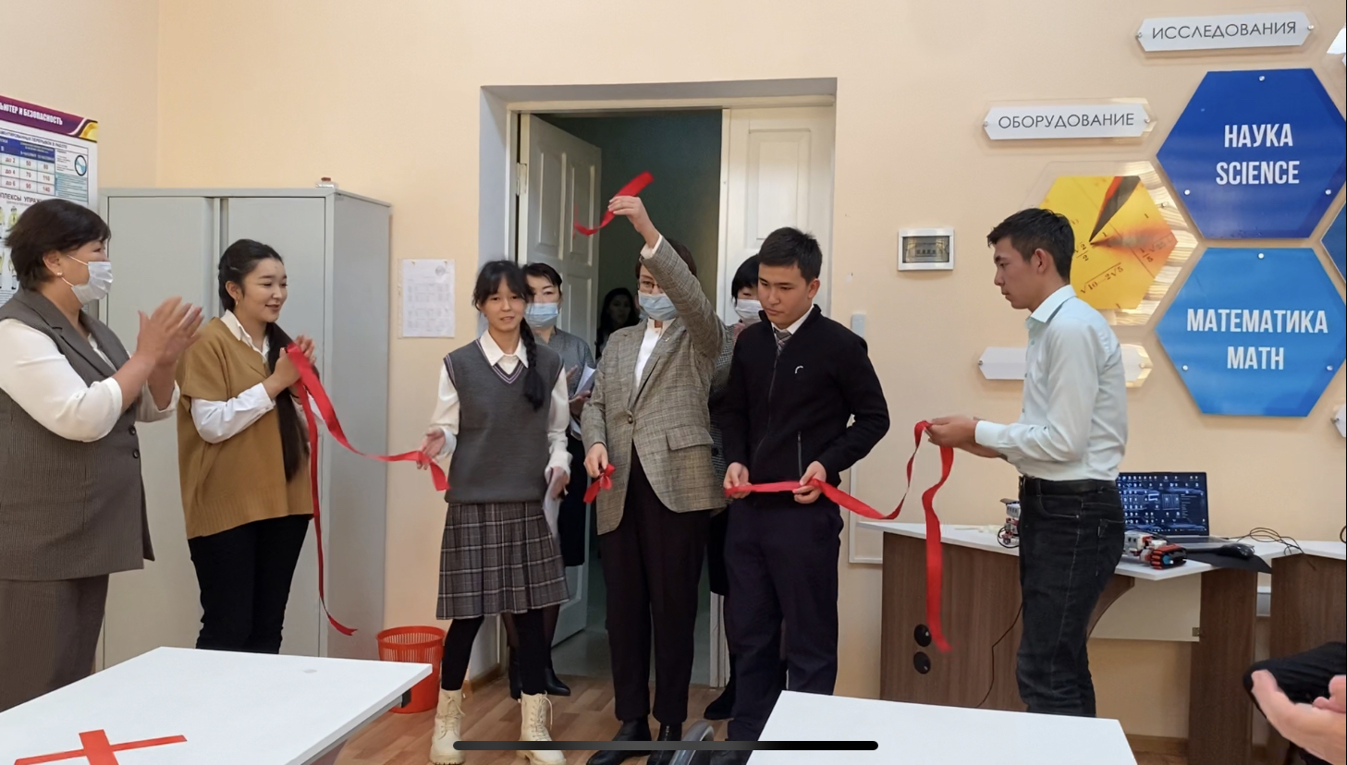
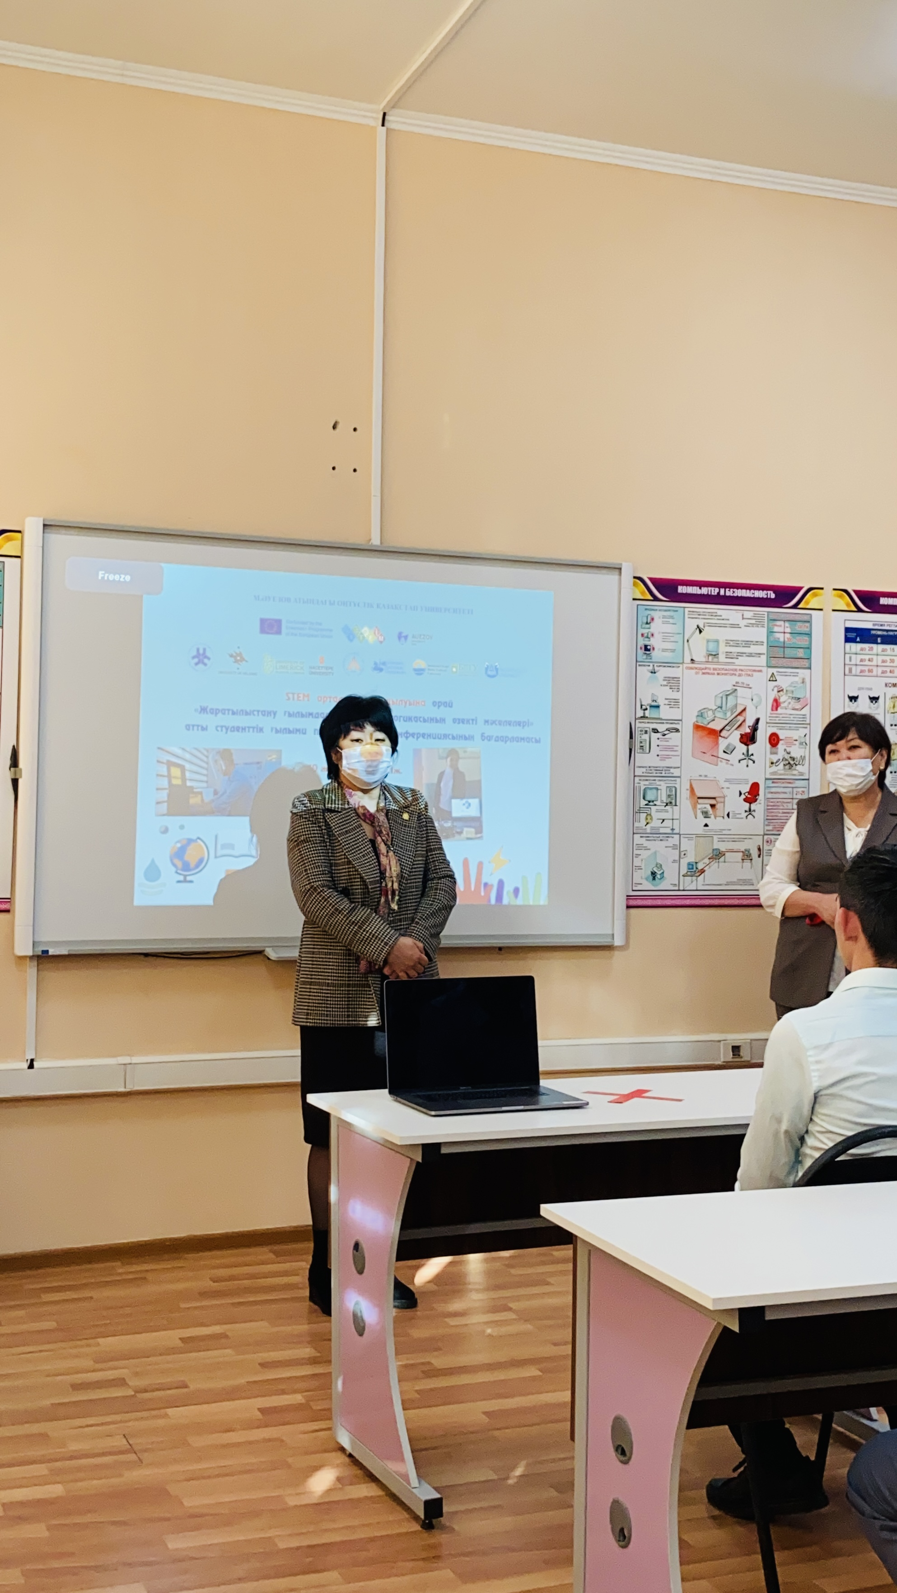
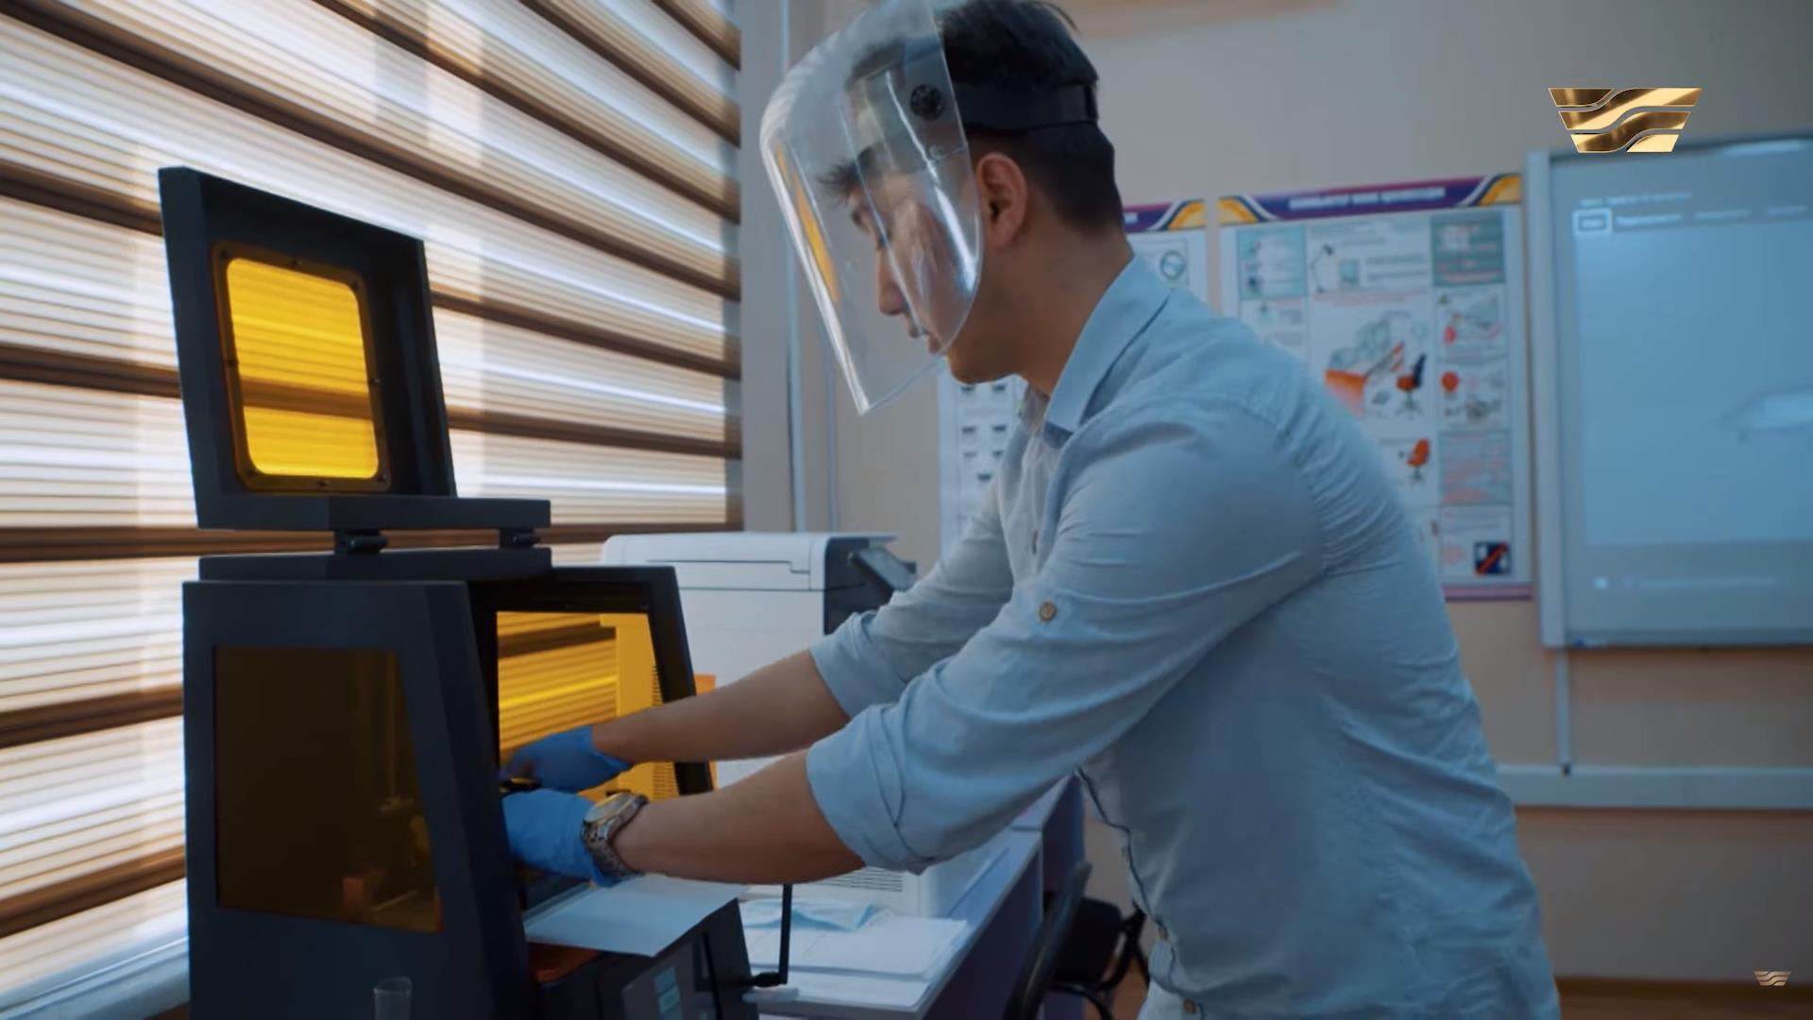
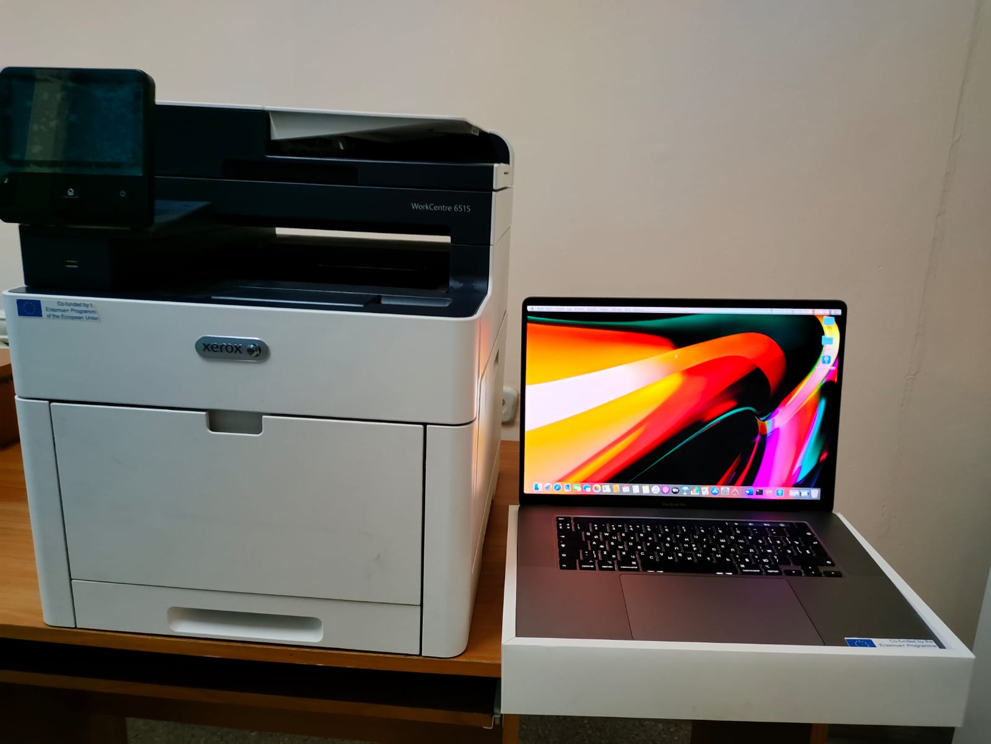
Ceremony of STEM center opening

Slide 10
Summer School:
•M. Auezov South Kazakhstan University held from July 27 to July 31, 2020the International Summer Online School "Modern Trends in STEM Education" in the framework of the project "Integrated Approach to STEM Teacher Training" of the Erasmus + program for students of educational programs in the field of educational and natural sciences, engineering, technology and future STEM teachers.
Information about Summer School : https://ukgu.kz/en/international-summer-online-school-modern-trends-stem-education-framework-project-integrated
The online format of the school made it possible to attract more than 60 listeners for work of the School

Slide 11
Dissemination of the project results
During realization of the project 4 STEM weeks and 8 STEM days, regional training for teachers were held at M.Auezov SKU.
As part of these events, participants shared their experience in the field of STEM education.
During the STEM weeks and STEM days, the speakers introduced the audience to global trends in education, inquiry-based learning and project-based learning methods; master students of the educational program presented their projects in the following areas:
1) the use of simulators of laboratory work related to the topic under study;
2) designing laboratory work with your own hands on the topic under study;
3) creation of simple models working on the principles of physics;
4) creation of simple robots.

Slide 12
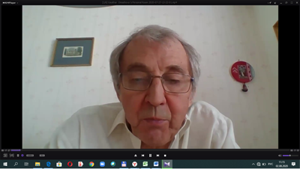
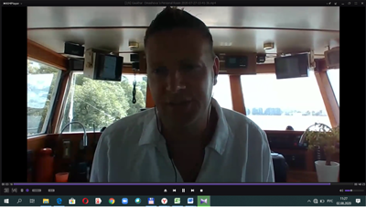
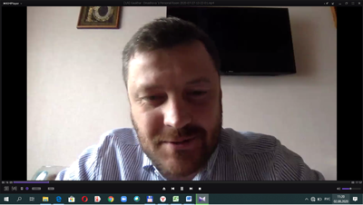
Presentations of Summer School

Slide 13
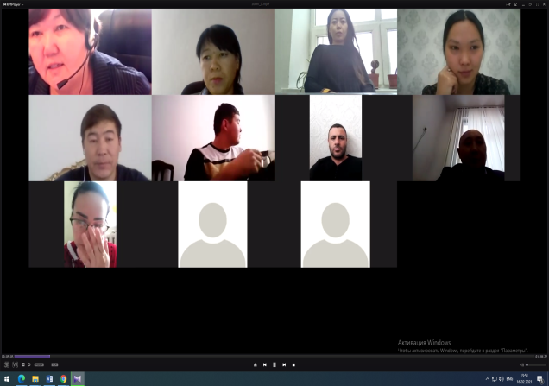
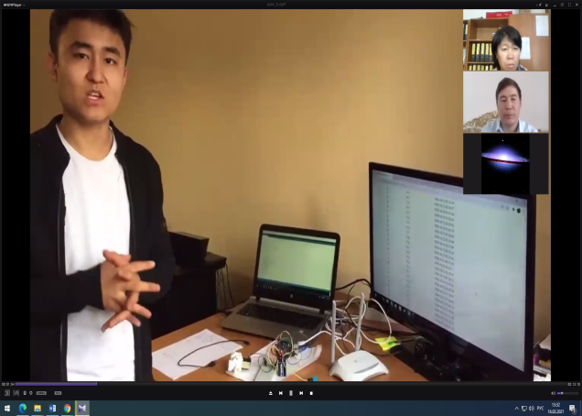
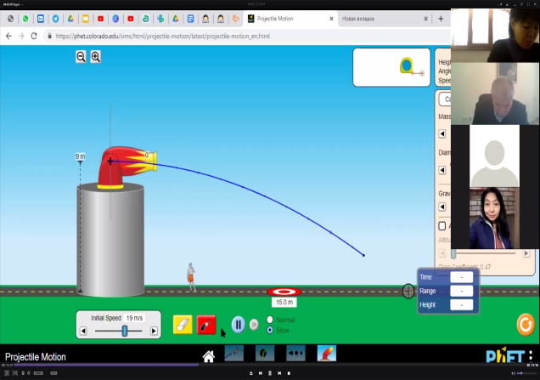
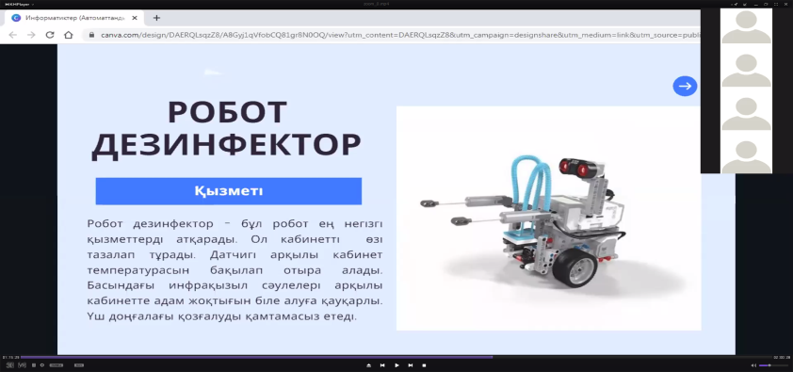
STEM-week in M. Auezov SKU

Slide 14
STEM events at M. Auezov South Kazkhstan University
STEM-taecher traning

Slide 15
M. Auezov South Kazakhstan University is very grateful for The ERASMUS+ program of the European Union and European partners for the valuable experience that we received during the realization of the project.
THANK YOU FOR YOUR ATTENTION!

